Slide 1


Insurance Management system
Himal basnet

Slide 2


INTRODUCTION
The insurance management system is a Java program that lets users maintain, modify, and purchase various insurance categories, sub-categories and policies. It has two users, an admin and a client. Admin can make all the necessary changes like client management, category management, sub-category management, policy management, and authorizing client requests for policy purchase. Clients can view and request to purchase the different policies.

Slide 3
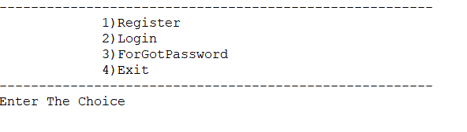
Main Menu
Register
Login
Forgot password
Exit

Slide 4
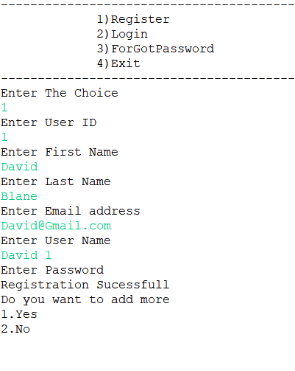
User registration
Users can Register their information and create their user Id and Password

Slide 5
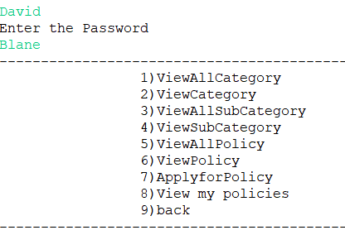
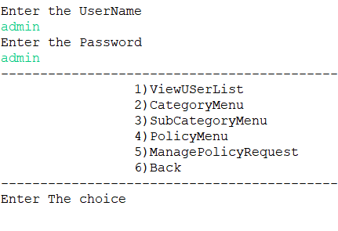
Client menu
Client can view categories, sib-categories, policies and make request to purchase.
Admin menu
Admin can manage the user list, category, sub-category, and policy.

Slide 6
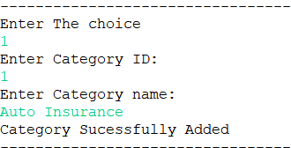
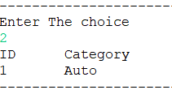
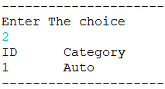
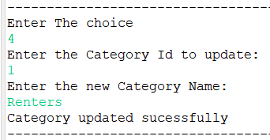
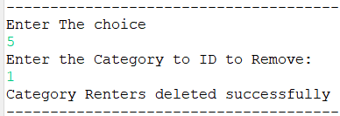
Categories menu
Admin menu
Add-Category
View all Category
View Category
Update Category
Delete Category
back

Slide 7
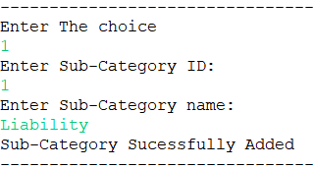
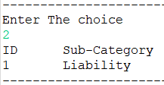
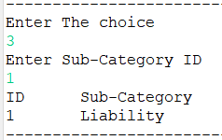
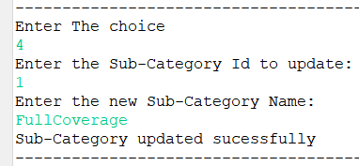
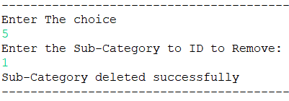
Sub-Categories menu
Admin menu
Add-Sub-Category
View all Sub-Category
View Sub-Category
Update Sub-Category
Delete Sub-Category
back

Slide 8
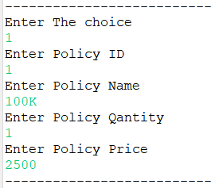
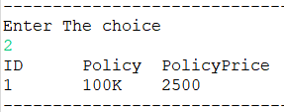
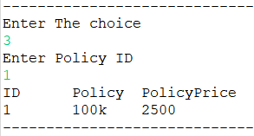
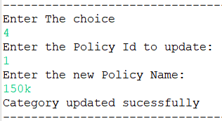
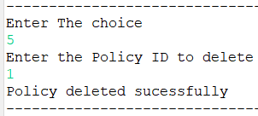
policy menu
Admin menu
Add-Category
View all Category
View Category
Update Category
Delete Category
back

Slide 9
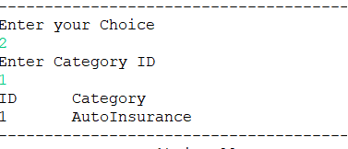
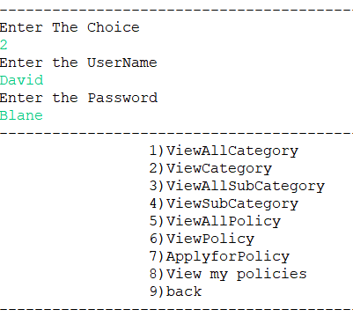
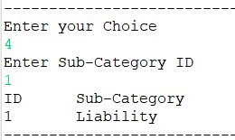
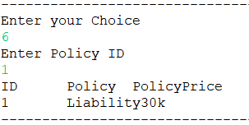
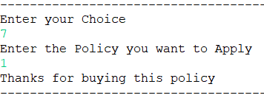
Client menu
Client can view category, sub-category, policy and request to purchase.

Slide 10
THANK YOU
Himal Baset

